Slide 1
ACC CRYO Top level system description

Slide 3
Operation
Operation
NA.CP
QCELL
LINAC
CRYO OK
(2K)
CRYO OK (2K)
LINAC in operation
(RF can be on)
n=yes
n-1=yes
n-m=tbd?
Affects FT of linac
Standby
(2K, 4K, 70K, 300K)
Standby (2K, 4K, 70K, 300K)
Cooldown
Cooldown
LINAC not in operation
(RF cannot be on)
Warmup
Warmup
Static
Transients

Slide 4
Operation
QCELL
LINAC
CRYO OK (2K)
LINAC in operation
(RF can be on)
n=yes
n-1=yes
n-m=tbd?
Affects FT of linac
Standby (2K, 4K, 70K, 300K)
Cooldown
LINAC not in operation
(RF cannot be on)
Warmup
Static
Transients

Slide 6
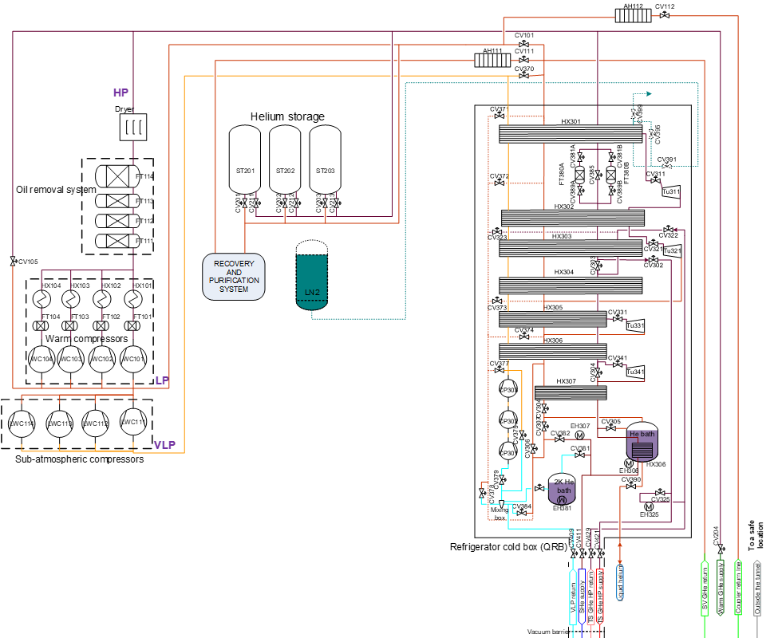
300 – 80 K
Moves GHe
80 – 40 K
Cold GHe

Slide 7
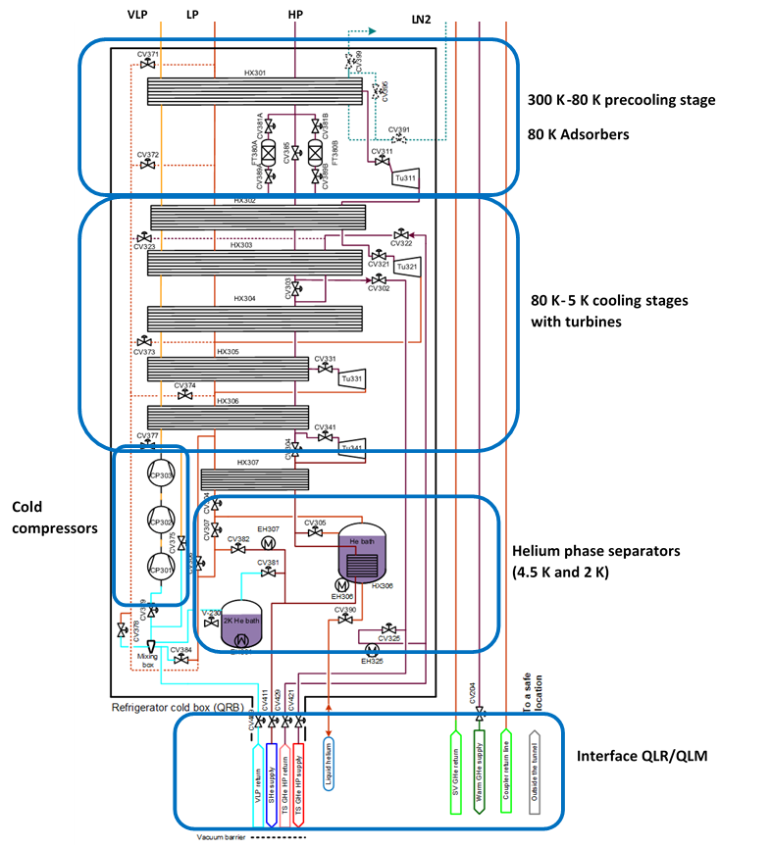
2
 | Warm compressors
3
5
1
4

Slide 8
QCELL 30
QCELL 1
QVE
p
T
m’
QVE
QCELL
NA.CP
TS
TS
TS
LINAC requirements
SRF conditions: T_CAV below 2 K
No df_cav =function(dp): p_CAV(t) within +0/-2 mbar
CAV
CAV
Tank
CPLR
CPLR

Slide 9
Transient
T
300
❶
❷
T, p, m
Towards 0
m
Q’
Circuit
❻
T, p, m
❹
❸
T, p, m
50
t
Steady
T
300
NA.CP
❶
❷
T, p, m
m
Q’
Circuit
QCELL shall not “spoil”
❻
T
❹
❸
T, p, m
50
t

Slide 10
Transient
T
300
❶
❷
T, p, m
Towards 0
m
Q’
Circuit
❻
T, p, m
B
❹
❸
T, p, m
50
A
 | A Supply T=4K | B Supply = f(t)
Efficiency (electrical) | Less efficient because dT is high | More efficient
Cool-down time | Faster due to larget dT gradient
Required cooling power | Requires larger cryoplant since innefficient
Control “coupling” between NA.CP and QCELL | Can be independent | Needs to match both temperatures
t
Steady
T
300
NA.CP
❶
❷
T, p, m
m
Q’
Circuit
QCELL shall not “spoil”
❻
T
❹
❸
T, p, m
50
t

Slide 11
Steady
100K
❶
❷
T, p, m
Line 1
Supplier sets the value for T1
Supplier sets the value for p1
m is adjusted as demanded (NA.CP adjusts)
Achieved by keeping p1 stable
Line 4
Target return T4
Target return p4
m is the sum of users
Circuit
Q’ heat load, which is static+dynamic. That is the disturbance
m6 is controlled so that T6 matches T4
p3-p1 is the driving force of m6, by controlling the valve
Work
❺
m
dT
50K
Q’
Circuit
❻
T
❹
❸
T, p, m
150K
Ideally NA.CP asks for steady dH = f(T, p, m)
Steady T1 and T4
Identical m1=m4
Special case of 2K-circuit has Cold Compressors
Very sensitive to variations in p and m

Slide 12
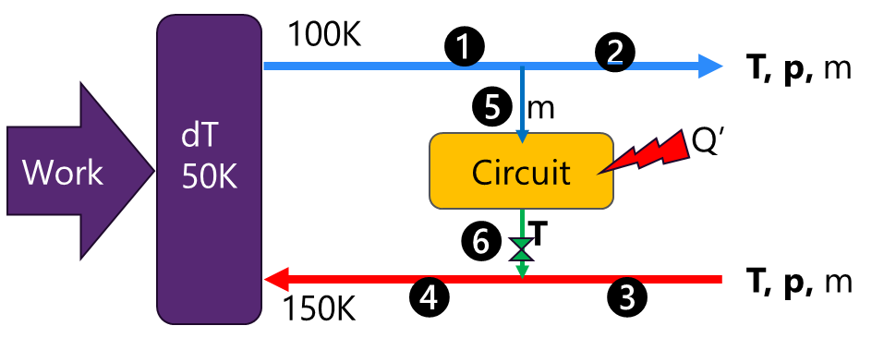
“2K-cryo operation” = Linac with beam
ACC CRYO
NA.CP
QCELL_i
Sets T1, p1
Sets T4, p4
Sets T_C and p_C
#Sets max_m6
Start
If p1 varies, adjust m1
Keep T_C within requirement
Keep p_C within range
This is done by adjusting m, which has to be conform with T4, within the constraints given by p4

Slide 13
“300-70K-cryo cooldown” = Linac is shutdown
LINAC
Cryo Operator
NA.CP
QCELL_i
Start cool down
Prepare system according “CSS PFD 80K CD”
T5
Gradient of T
ready
T_Ci
Prepare system according “QCELL PFD 80K CD”
T6
ready
T
Sets max. allowed dT = T4-T1
Start
If p1 varies, adjust m1
Protects itself of too high dT=T_Ci-T1, by adjusting m
50
t

Slide 14
From QCELL Design Activities (SCK CEN/83017932)v
QCELL Stakeholders (Users and Services)
Users
QCELL Equipment
Services
MDB Teams
Domain
RF-Payload
Cryo Cell [QCELL]
Cryo Supply System [NA.CP]
RCU
SRF
SRF Cavity [CAV]
Cryomodule [QM]
Cryoplant [NA.C01]
ACM
Mech, xVAC
Cold Tuner [TUN]
Cryo Distribution [NA.CP02]
ACR
CRYO
Valve Box [QVB]
Cryo Infrastructure [NA.CP03]
ICS
C&C
RF Coupler [CPLR]
NFS
Utilities,
Cryoplant
Insulation Vacuum [INVAC]
Mag. Shield [MGS]
Cryo Controls “QCIS”
Mech. Design
Utilities ACC [NA.xx]
Controls & Interlocks [CIS]
Beam Vacuum
[BVAC[
Cooling Water [NA.CP01]

Slide 15
From QCELL Design Activities (SCK CEN/83017932)v
QCELL Stakeholders (Users and Services)
Users
QCELL Equipment
Services
MDB Teams
Domain
RF-Payload
Cryo Cell [QCELL]
Cryo Supply System [NA.CP]
RCU
SRF
SRF Cavity [CAV]
Cryomodule [QM]
Cryoplant [NA.C01]
ACM
Mech, xVAC
Cold Tuner [TUN]
Cryo Distribution [NA.CP02]
ACR
CRYO
Valve Box [QVB]
Cryo Infrastructure [NA.CP03]
ICS
C&C
RF Coupler [CPLR]
NFS
Utilities,
Cryoplant
Insulation Vacuum [INVAC]
Mag. Shield [MGS]
Cryo Controls “QMCS”
Mech. Design
Utilities ACC [NA.xx]
Controls & Interlocks [CIS]
Beam Vacuum
[BVAC[
Cooling Water [NA.CP01]

Slide 16
From QCELL Design Activities (SCK CEN/83017932)v
CRYO Stakeholders (Users and Services)
Users
QCELL Equipment
Services
MDB Teams
Domain
RF-Payload
Cryo Cell [QCELL]
Cryo Supply System [NA.CP]
RCU
SRF
SRF Cavity [CAV]
Cryomodule [QM]
Cryoplant [NA.C01]
ACM
Mech, xVAC
Cold Tuner [TUN]
Cryo Distribution [NA.CP02]
ACR
CRYO
Valve Box [QVB]
Cryo Infrastructure [NA.CP03]
ICS
C&C
RF Coupler [CPLR]
NFS
Utilities,
Cryoplant
Insulation Vacuum [INVAC]
Mag. Shield [MGS]
Cryo Controls “QMCS”
Mech. Design
Utilities ACC [NA.xx]
Controls & Interlocks [CIS]
Beam Vacuum
[BVAC[
Cooling Water [NA.CP01]

Slide 17
Function: provide 2K refrigeration
What is needed
A VLP line
SHe supply
Generates 2K

Slide 18
Copyright © SCK CEN
All property rights and copyright are reserved.
This presentation contains data, information and formats for dedicated use only and may not be communicated, copied, reproduced, distributed or cited without the explicit written permission of SCK CEN.
If this explicit written permission has been obtained, please reference the author, followed by ‘by courtesy of SCK CEN’.
Any infringement to this rule is illegal and entitles to claim damages from the infringer, without prejudice to any other right in case of granting a patent or registration in the field of intellectual property.
SCK CEN
Belgian Nuclear Research Centre
Studiecentrum voor Kernenergie
Centre d'Etude de l'Energie Nucléaire
Foundation of Public Utility
Stichting van Openbaar Nut
Fondation d'Utilité Publique
Registered Office:
Avenue Herrmann-Debrouxlaan 40 - 1160 BRUSSELS - Belgium
Research Centres:
Boeretang 200 - 2400 MOL - Belgium
Chemin du Cyclotron 6 - 1348 Ottignies-Louvain-la-Neuve - Belgium

Slide 21
ARCHITECTURE

Slide 22
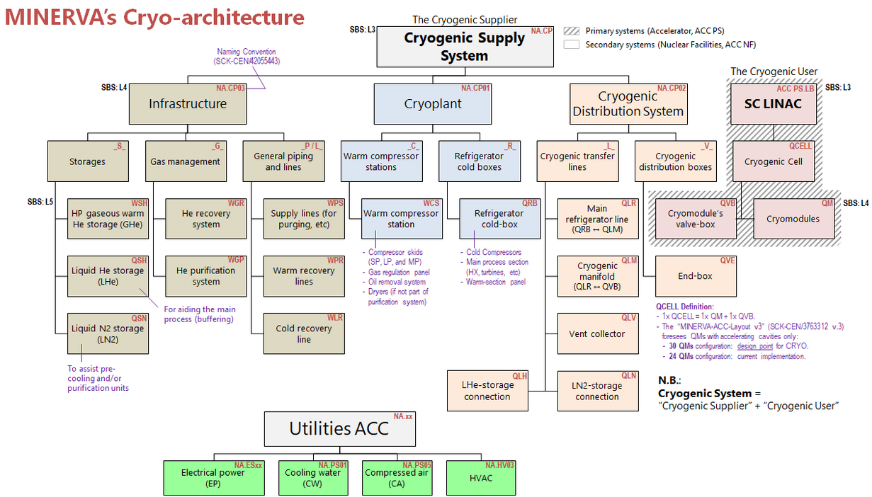
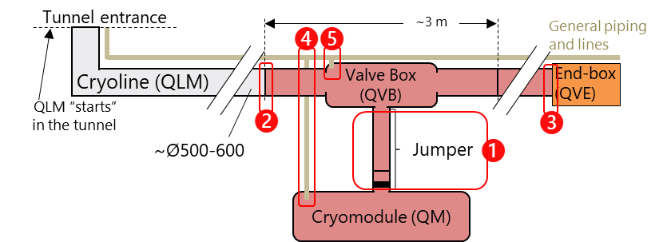
TOP-Level CRYO Interface
ACC NF
MYR-6093
ACC PS
MYR-6093 Cryogenic System IARD
Defines ACC ADR of CRYO System in top-down approach:
from SBS lvl 2 (ACC NF//ACC PS) down to SBS lvl 4 (NA.CPxx//QCELL)
NA-CP
(LINAC LB)
NA-CP01
NA-CP02
NA-CP03
QCELL
Design Decisions:
Pressure drop budgets: 7mbar
Questions:
Where to document the top-level CRYO System (NA.CP + QCELLs)? Two options
Create an ARD of ACC specific for cryogenics
Create an IARD of the top-level cryogenics interface ACC NF//ACC PS
What about PTF user? Is it part of ACC PS?

Slide 23

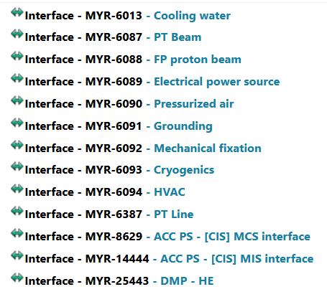
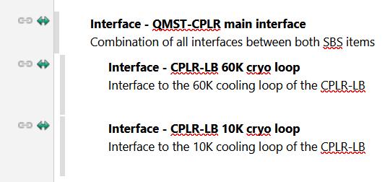
ACC PS
ACC NF
ACC PS
ACC NF
LINAC
NA.PS
NA.CP02
NA.CP
cryo
QCELL
QCELL
NA.PS05
air
NA.PS
Process
NA.xx
NA.xx
[NA.CP02] QLM
Tunnel cryoline
QVB
Missalignment in representation
[NA.CP03] WPR
Warm return piping
[NA.PS05] xxx
Compressed air
Generic interface
Water
Air
cryo
[QVB] terminal point
[NA.PS05] terminal point
Pressurized air, line for valve #123
Generic interface
Water
Air
cryo
Airflow, mechanical connection, etc…

Slide 24
ACC PS
ACC NF
ACC PS
ACC NF
NA.xx
NA.CP02
NA.CP
cryo
[Section]
CELLs
NA.PS05
air
NA.PS
Process
NA.xx
NA.xx
[NA.CP02] QLM
NA.PS05
Tunnel cryoline
QVB
QVB
[NA.CP03] WPR
Warm return piping
ACC ADR
ACC PS // NA.CP
ACC PS // NA.PS
ACC PS // NA.xx
ACC-PS ADR
“cell” // NA.PS01
“cell” // NA.PS02
QM
[NA.PS05] xxx
Compressed air
[QVB] terminal point
[NA.PS05] terminal point
Pressurized air, line for valve #123
Airflow, mechanical connection, etc…

Slide 25
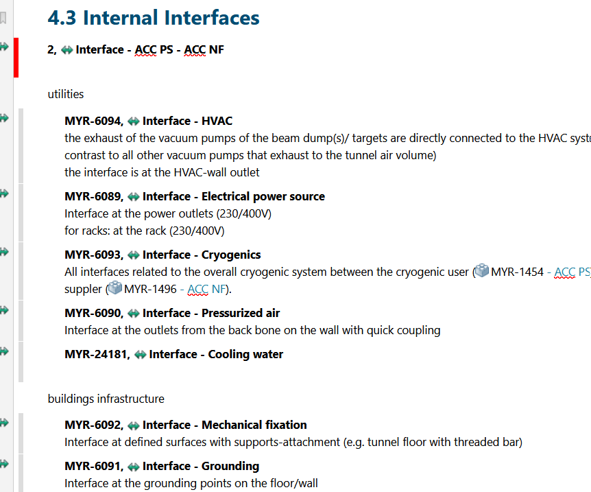
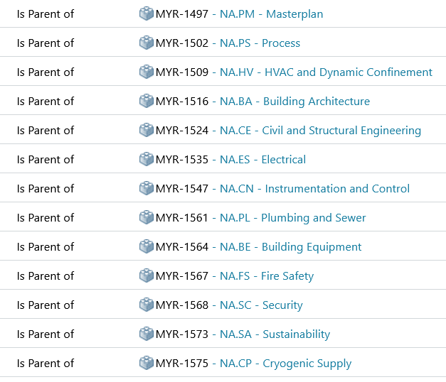
Defined in
ADR of…
ACC
ACC PS
Utilities
ACC NF
QCELL
child
PS
ACC-PS
SRFCELL
Water
PS03
xCELL
….
xCELL
CPLR
Purified Water
PS03.xx
xDevice
SSA
Normal Water
xCELL
xxxx
Water 20degC
PS07.xx.yy
Terminal point
xxxx

Slide 26
Defined in
ADR of…
ACC
ACC PS
services
ACC NF
QCELL
child
PS
ACC-PS
SRFCELL
Water
PS03
xCELL
….
xCELL
CPLR
Purified Water
PS03.xx
xDevice
SSA
Normal Water
xCELL
xxxx
Water 20degC
PS07.xx.yy
Terminal point
xxxx

Slide 27
Defined in
ADR of…
ACC
ACC PS
services
ACC NF
QCELL
child
PS
ACC-PS
SRFCELL
Water
PS03
xCELL
….
xCELL
CPLR
Purified Water
PS03.xx
xDevice
SSA
Normal Water
xCELL
xxxx
Water 20degC
PS07.xx.yy
Terminal point
xxxx

Slide 28
OCD
REQ
ACC-PS
ADR
OCD
REQ
OCD
REQ
QCELL
SRFCELL
ADR
ADR
OCD
REQ
QM
ADR
CPLR
LLRF
IADR
CPLR
OCD
REQ
Design Note
Fine tuning vs coarse tuning

Slide 29
OCD
REQ
ACC-PS
ADR
OCD
REQ
OCD
REQ
QCELL
SRFCELL
ADR
ADR
OCD
REQ
QM
ADR*
*cherry picks items from QCELL&SRFCELL
QCELL
SRFCELL
CPLR
OCD
REQ
QM
Design Note
Fine tuning vs coarse tuning
CPLR
LLRF
IADR

Slide 30
ACC CRYO
OCD
ADR
OCD
REQ
ACC-PS
ADR
OCD
REQ
OCD
REQ
QCELL
SRFCELL
ADR
ADR
OCD
REQ
SRFCELL
QM
QCELL
ADR*
*cherry picks items from QCELL&SRFCELL
OCD
REQ
QM
CPLR
Design Note
Fine tuning vs coarse tuning
CPLR
LLRF
IADR

Slide 31
Proposal
OCD: Overall operational concept
ACC PS
Q-Cell
RF-Cell
DF-Cell
Beam VAC
Insul. VAC
QM
CAV
BD
ICD
SRC-Cell
Girders & supports
ADR:
Machine physics
Reliability modeling
Integration
Cryo architecture
RF architecture
Beam vacuum architecture
Insulation vacuum architecture
?
?
DF devices architecture (incl. PCO’s)

